Slide 1
Acquisition and extensive analysis of data from eBike
Nizam Ahmad
Fahad Aziz
Farhan Ali
Supervisor: Dr. Bilal Habib

Slide 2
Outlines
Project info
Problem statement
Project idea
Project equipment details
Signal generator
Sampling
Timer and interrupts
SD module
Calculating speeds
Voltage and current sensor
Remaining milestones

Slide 3
Project info
Electric bike known as E-Bike
E-Bike use rechargeable batteries which is coupled to electric motor
Lighter varieties ( 25 to 32 km/h)
High-powered varieties (45 km/h)
The range of E-Bike is dependent on battery, weight of the rider, location and speed you are traveling

Slide 4
Problem Statement
Electric bikes are associated with the range-anxiety. It means the rider, or the driver is always anxious about the potential range that can be achieved with the available electric power. We plan to mitigate this problem in our project.

Slide 5
Project Idea
In this project, we will develop a system to collect data using IoT sensors for optimal battery usage
We plan to extract the sensor data using microcontrollers. These controllers have built-in ADCs (analog-to-digital converters). The data extracted will be stored in the memory. Furthermore, we plan to upload it to the cloud

Slide 6
Project Equipment Details
Ardunio UNO (16MHz)
Oscilloscope
Signal generator
Current and voltage sensors
Multi-meter
SD modules + SD card (16GB)

Slide 7
Generating Signals
Generate signals (10Hz, 100Hz, 1KHz, …)
We give the signal to the microcontroller
ADC convert signals into a digital signals

Slide 8
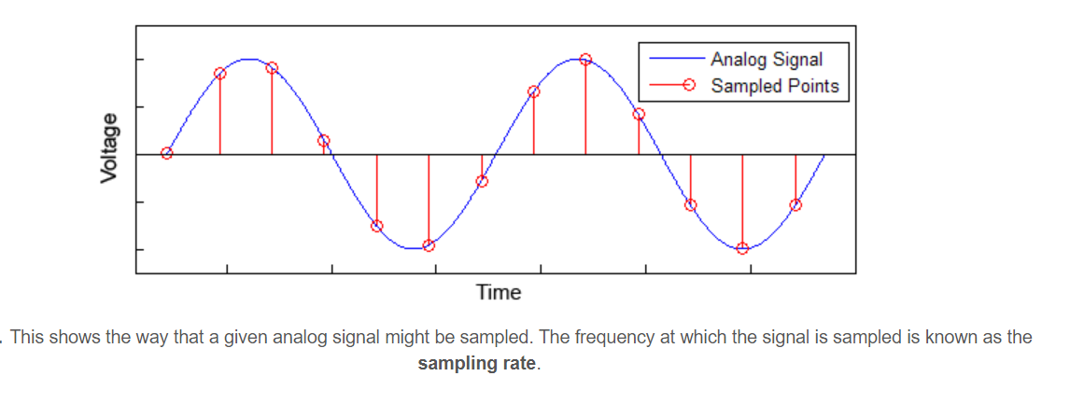
Sampling

Slide 9
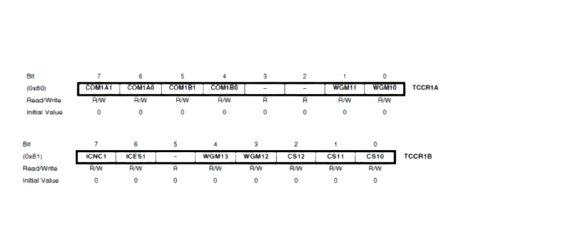
Timer1 You can change the Timer behavior through the timer register. The most important timer registers are: TCCRx - Timer/Counter Control Register. The prescaler can be configured here.

Slide 10
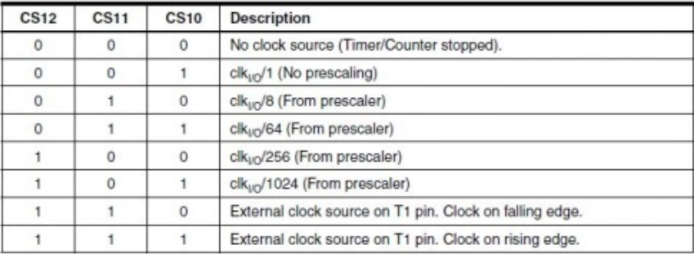
Timer1

Slide 11
Timer Code
void setup() {
TCCR1A = 0;
TCCR1B = 0;
TCNT1 = 0;
OCR1A = 1; // compare match register 16MHz/256/2Hz
TCCR1B |= (1 << WGM12); // CTC mode
TCCR1B |= (1 << CS10); // 62 prescaler
TIMSK1 |= (1 << OCIE1A); // enable timer compare interrupt
interrupts(); // enable all interrupts
}

Slide 12
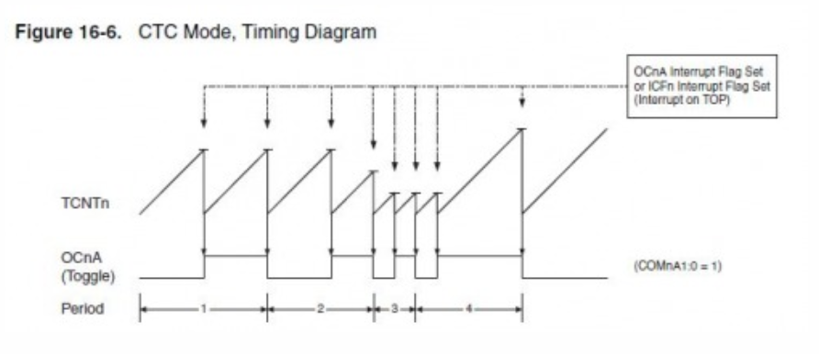
Timing Diagram

Slide 13
Interrupt Service Routine
ISR(TIMER1_COMPA_vect) // timer compare interrupt service routine
{
digitalWrite(8, !digitalRead(8));
if (countC <= 10000){
countC++;
int Latd = analogRead(A0);
}
else{
file.close();
}

Slide 14
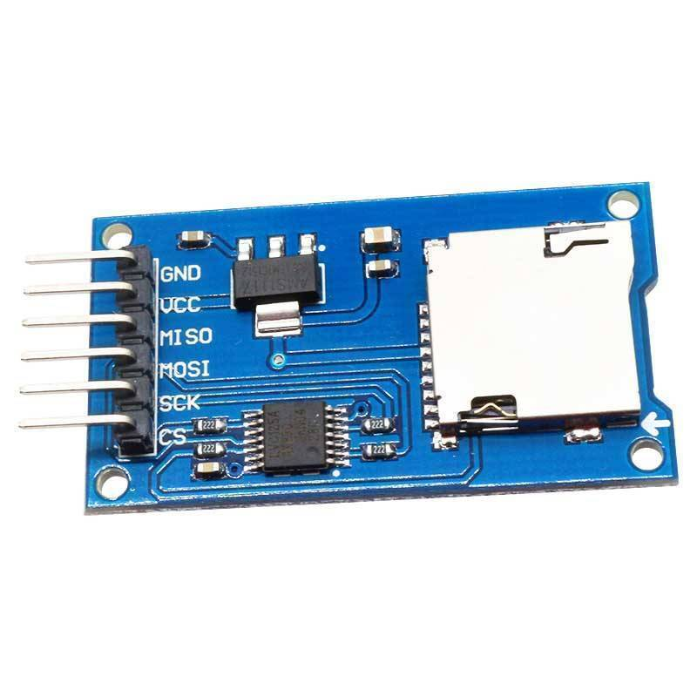
SD modules
Connect VCC with 5V in the Arduino.
Then, connect the GND of SD card to the ground of Arduino.
Connect CS to pin 14
Connect SCK to pin 13
MOSI connect to the pin 11
Lastly, connect MISO to pin 12

Slide 15
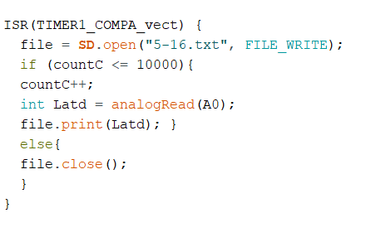
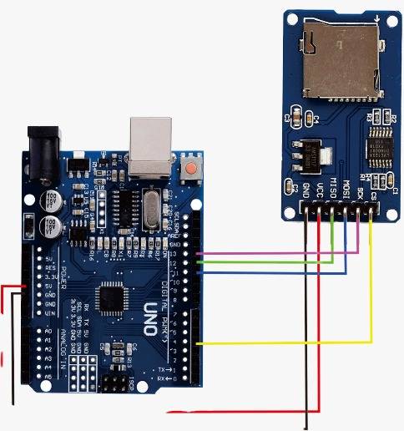
Designing SD module
Code
Design

Slide 16
Testing
Missing cycles
Maximum analog-to-digital conversion speed
Maximum Transferring speed

Slide 17
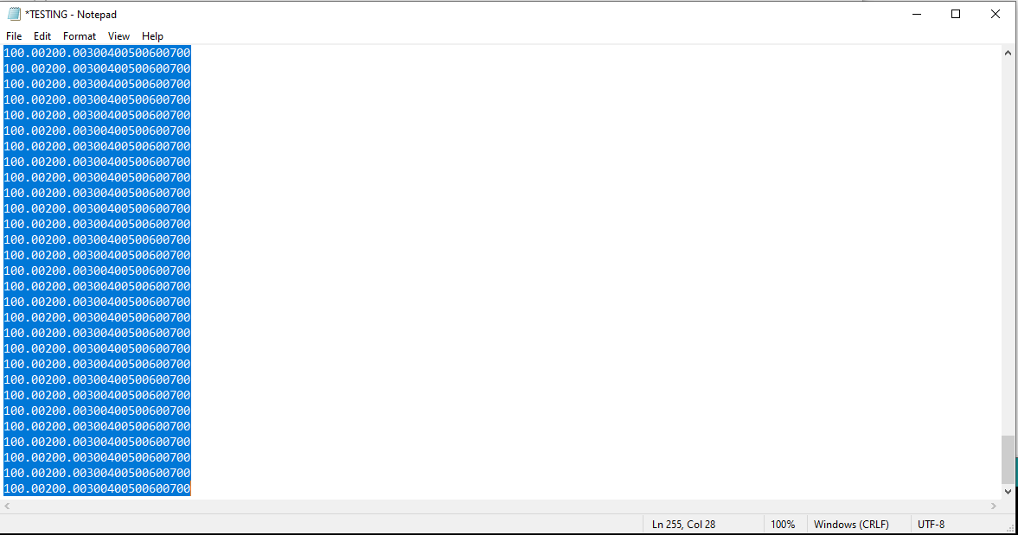
Test1 (missing cycle)

Slide 18
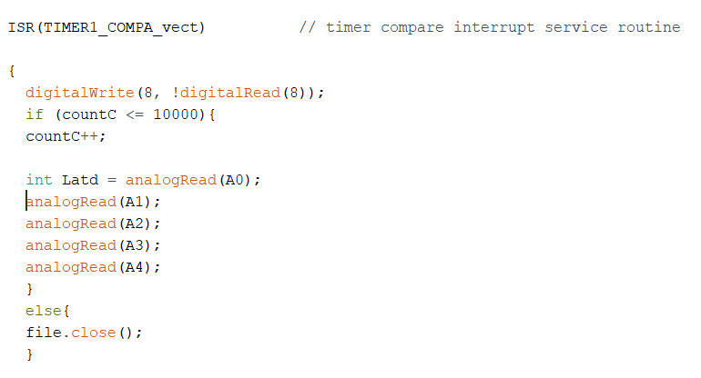
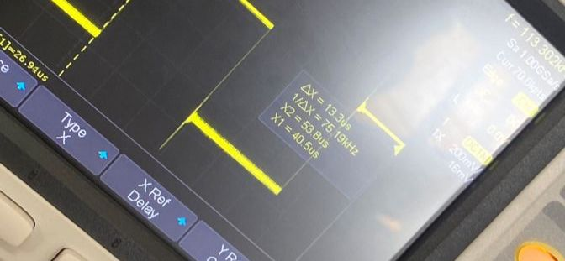
analog-to-digital conversion speed

Slide 19
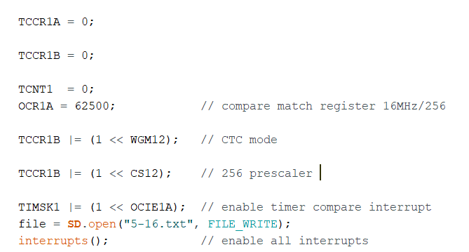
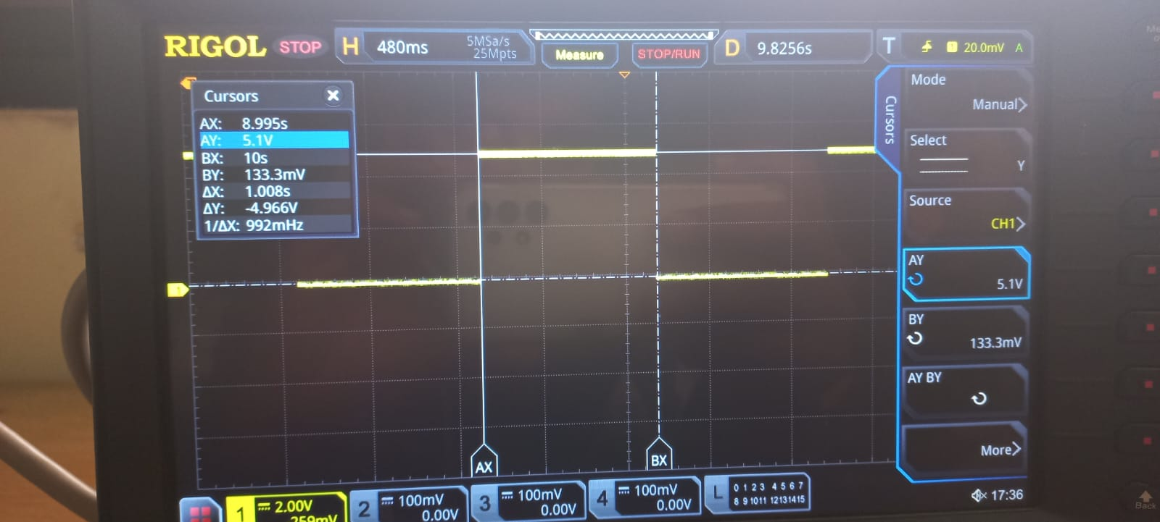
Transferring speed
256 prescaler

Slide 20
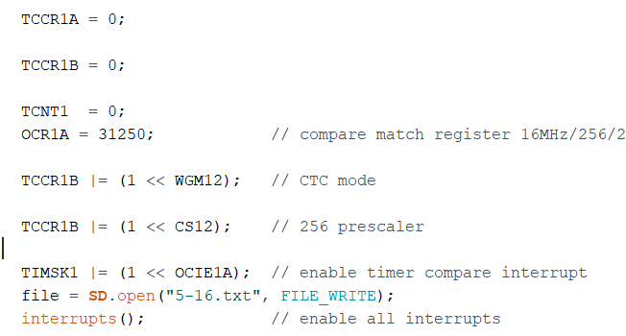
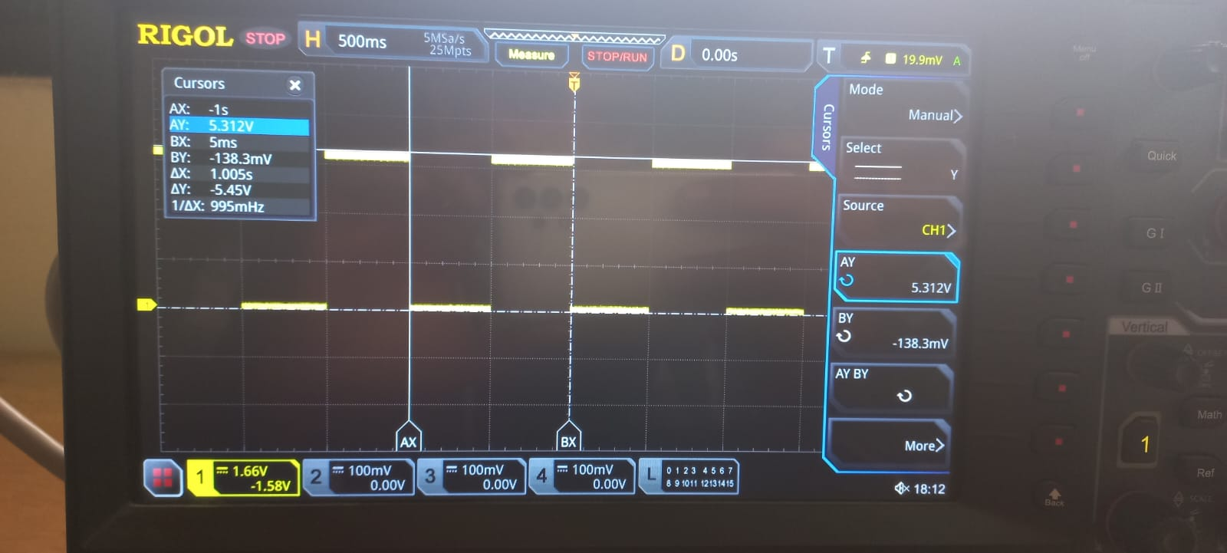
Transferring Speed

Slide 21
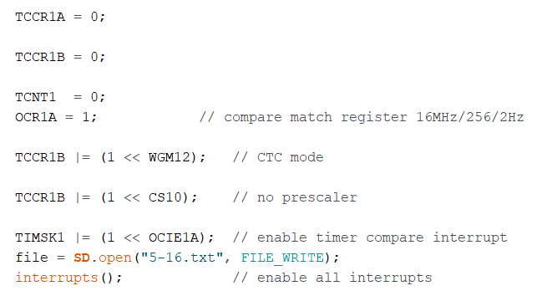
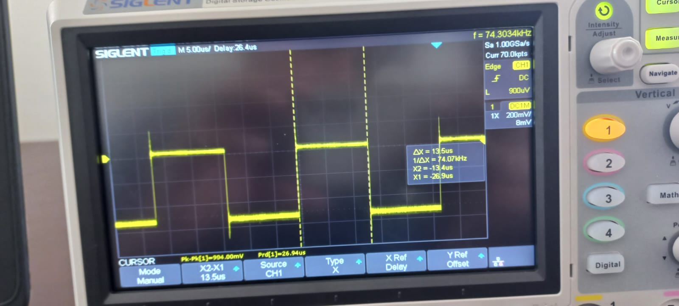
Transferring Speed (Max)

Slide 22
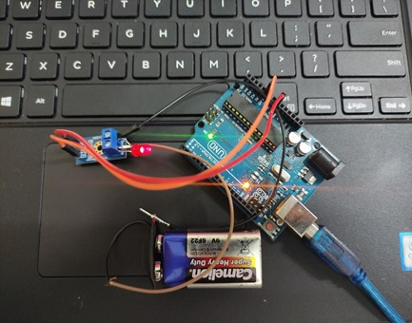
Voltage Sensor Design

Slide 23
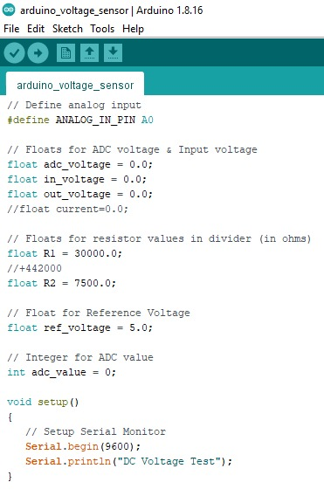
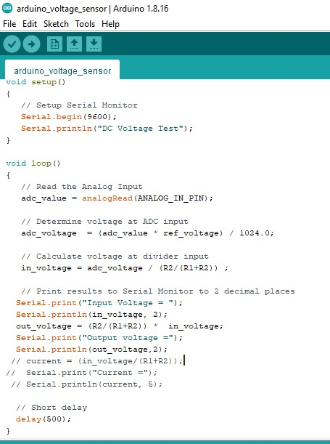
Voltage sensor

Slide 24
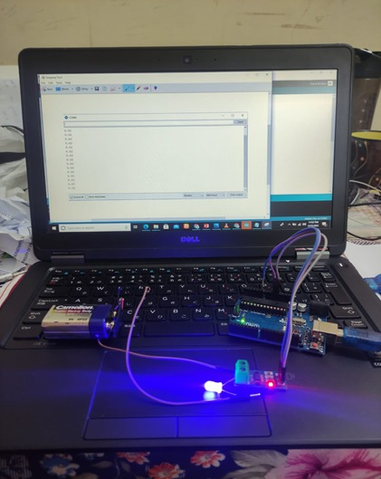
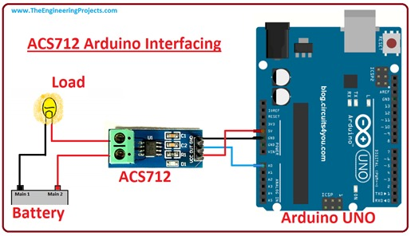
Current sensor

Slide 25
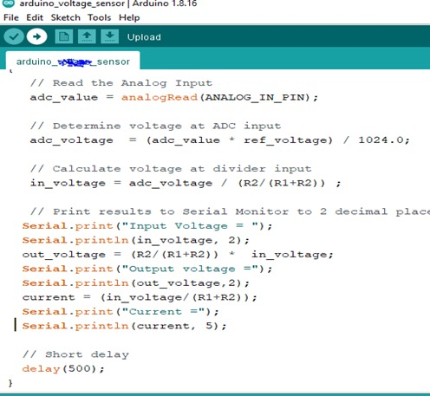
Current sensor code

Slide 26
Remaining milestone
Elapsed time in weeks | milestones
8th semester – week13 | Designing GPS Sensor
8th semester – week14 | Testing on real system
8th semester – onwards | Upload data to the cloud

Slide 27
Thank you!!

